Slide 1
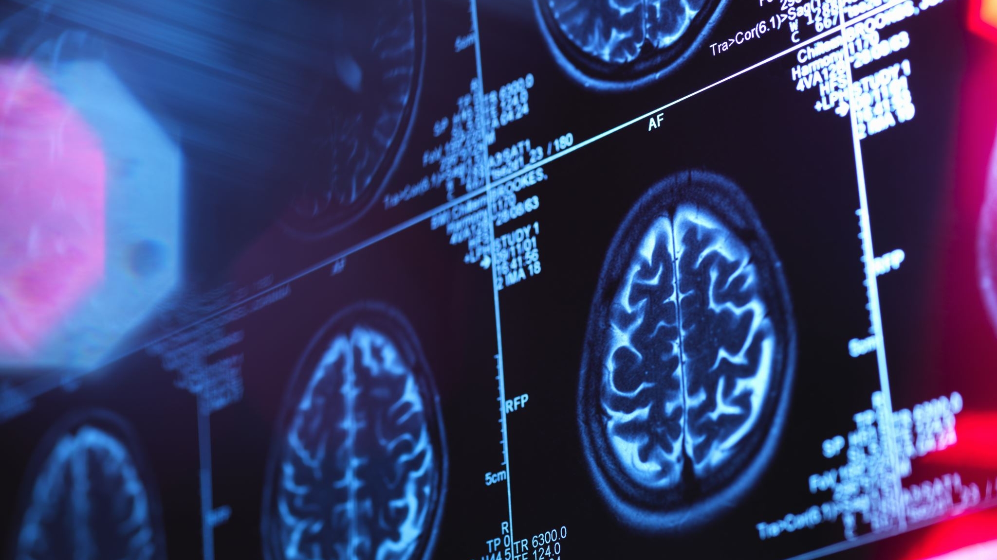
Final Project: X-Ray Fracture Prediction
By Ian Roberson

Slide 2
Challenges
Training a model on a large database takes a long time
6+ hours for 4000 128x128 images
All images must be converted to the same format (grayscale, size)

Slide 3
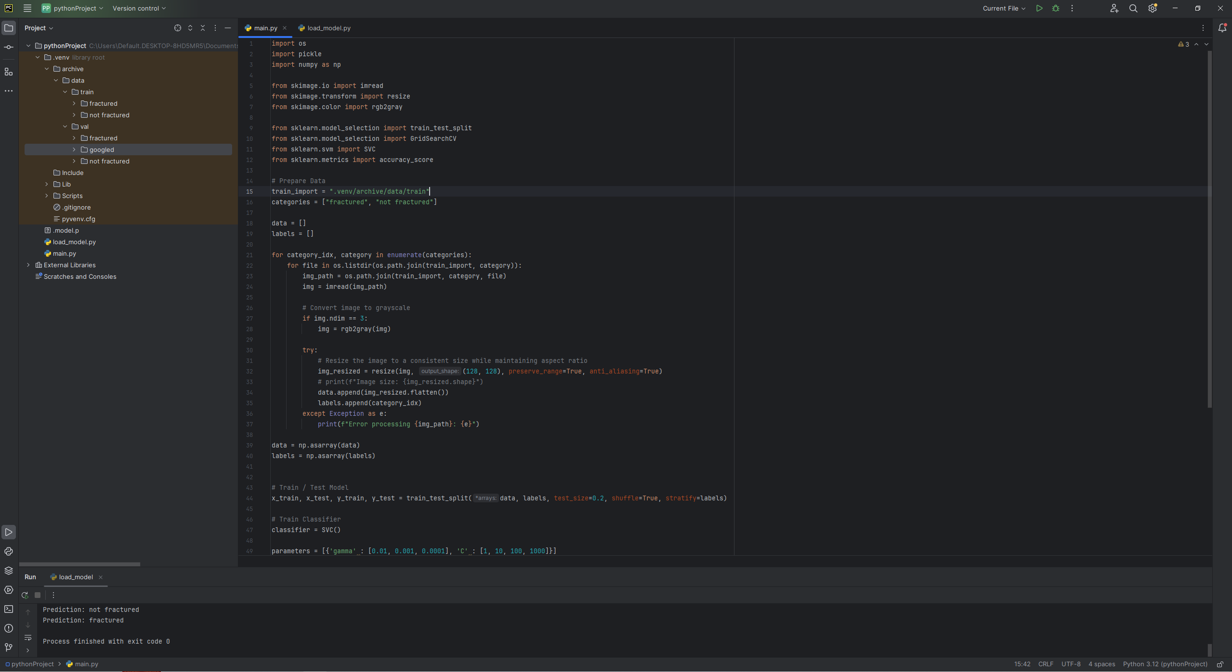
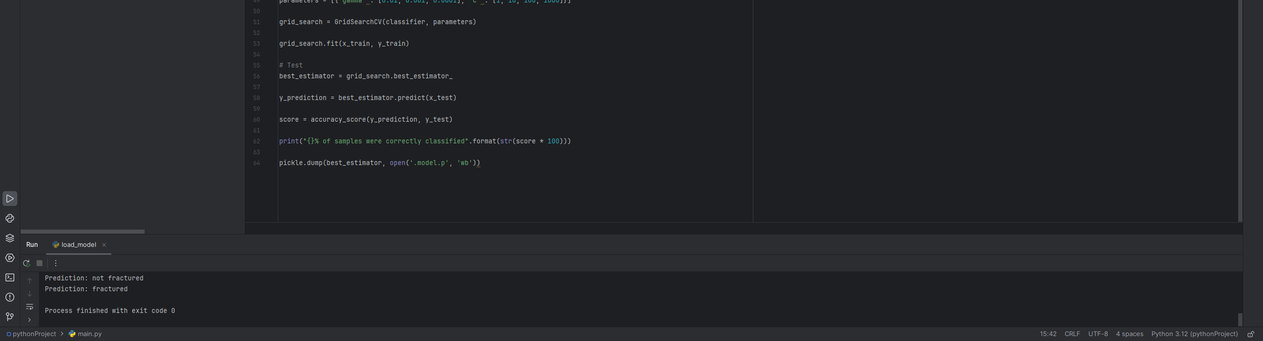
Model Code

Slide 4
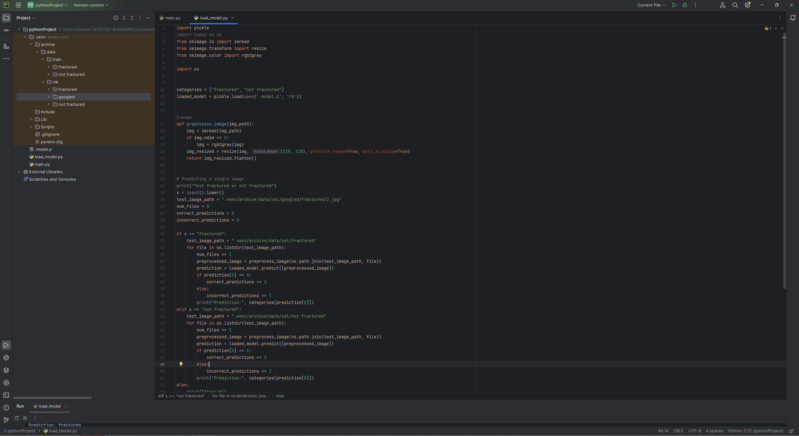
Test Code

Slide 5
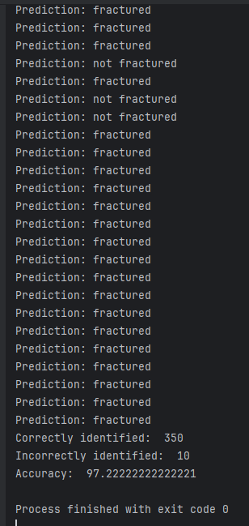
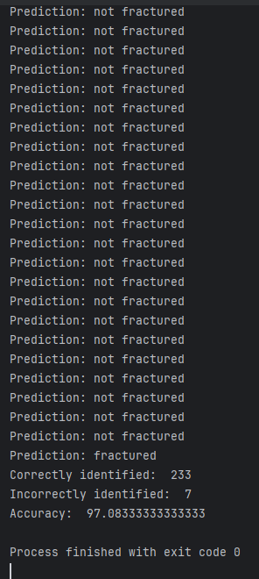
Current State – Mostly Finished
Can predict x-rays with fractures with 97% accuracy
Can predict x-rays without fractures with 97% accuracy

Slide 6
Current Issues
Model size is 400mb which is over the 100mb size limit on GitHub

Slide 7
Questions

